Slide 1
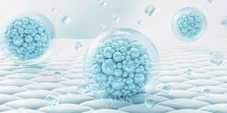
Exosomes
HAIR & skincare treatment

Slide 2
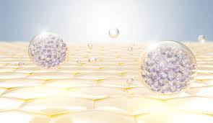
Exosomes
HAIR CARE
SKINCARE

Slide 3

EXOSOMES
HAIR CARE EXOSOMES
SKINCARE EXOSOMES
SUMMARY OF MESOSYSTEM EXOSOMES
TREATMENT PROTOCOL

Slide 4
EXOSOMES
HAIR CARE EXOSOMES
SKINCARE EXOSOMES
SUMMARY OF MESOSYSTEM EXOSOMES
TREATMENT PROTOCOL

Slide 5
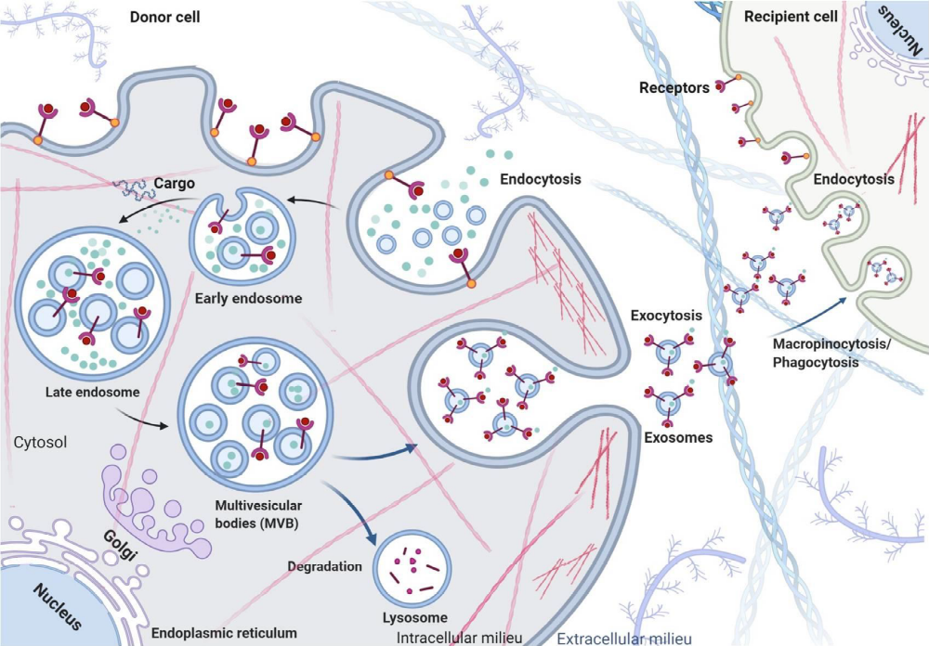
Exosomes
Exosomes are intercellular vesicles that allow the transport of substances between cells and are derived from the cell membranes naturally present in them. This communication system uses extremely small vesicles (30-150 nm), but with high concentrations of substances such as growth factors, proteins, lipids, DNA and RNA essential for cellular functioning. Thus, they have anti-inflammatory, antioxidant and anti-aging functions.

Slide 6
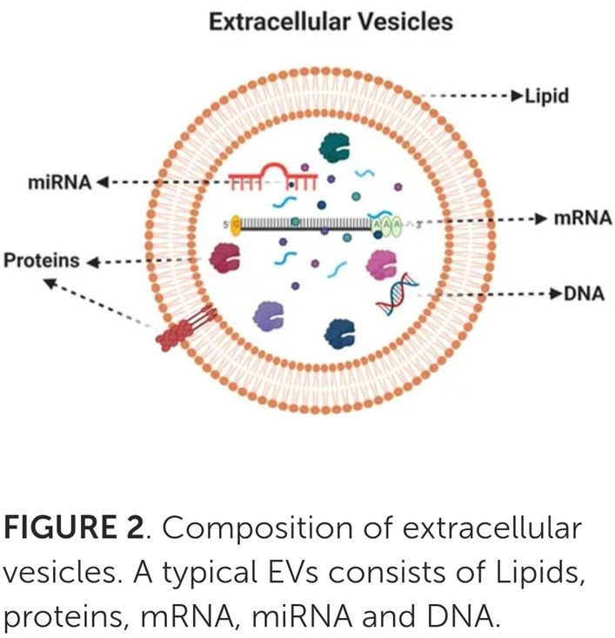
EXOSOMES
DEFINITION & STRUCTURE
Lipid bilayer vesicles (also called extracellular vesicles or EVs).
30–150 nm in diameter.
Produced and secreted by different cells/origins:
Plants
Milk
Fibroblasts and stem cells
Immune system cells (T cells, B cells, dendritic cells)
Perform essential functions in cell-to-cell communication.
Composition:
Lipids, proteins, genetic material (mRNA, miRNA, DNA).
DOI: 10.3389/fcell.2022.963278
DOI: 10.1016/j.jbiosc.2023.11.001
DOI: 10.1016/j.jconrel.2022.05.027

Slide 7
Exosomes
REGULATION OF BIOLOGICAL FUNCTIONS
WOUND HEALING
ANTI-INFLAMMATORY EFFECT
IMMUNOMODULATORY EFFECT
ANTIOXIDATIVE EFFECT
DOI: 10.3389/fcell.2022.963278

Slide 8
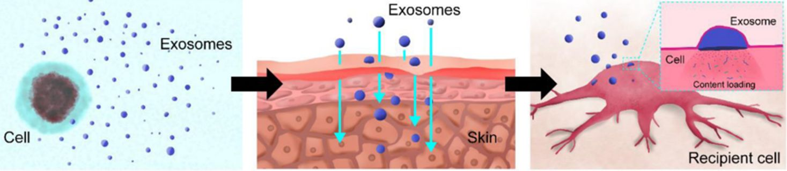
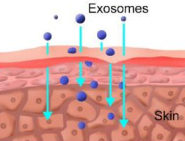
EXOSOMES
TYPES OF PENETRATION ROUTES INTO THE SKIN
As natural vehicles at nanoscale:
Easy internalization/cutaneous penetration.
Can cross biological barriers (skin) and go to the cellular target to exert its benefits.
DOI: 10.1186/s40824-021-00224-8
DOI: 10.3390/bioengineering10010104
DOI: 10.1016/j.ymthe.2020.11.030

Slide 9
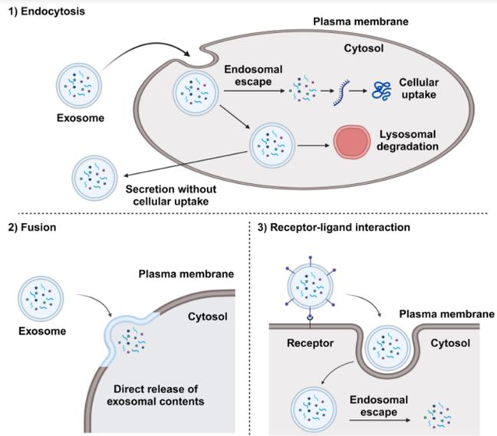
EXOSOMES
TYPES OF SKIN PENETRATION ROUTES
As natural nanometric vehicles:
3 cellular uptake routes for the internalization of cellular exosomes:
Membrane fusion
Endocytosis
Receptor-ligand interactions
Target cell
DOI: 10.1186/s40824-021-00224-8
DOI: 10.3390/bioengineering10010104
DOI: 10.1016/j.ymthe.2020.11.030
DOI: https://doi.org/10.1038/s12276-024-01201-6
Cellular uptake routes of exosomes

Slide 10
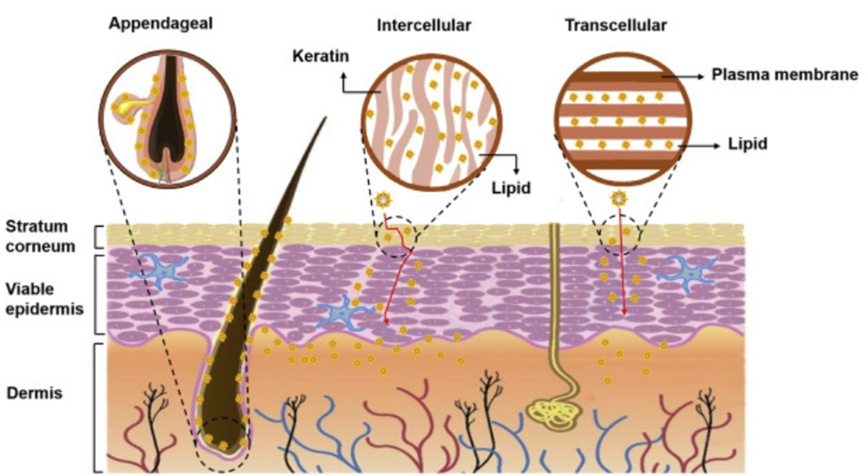
EXOSOMES
TYPES OF PENETRATION ROUTES INTO THE SKIN
As natural nanometric vehicles:
3 routes of penetration into the skin:
Transcellular (or intracellular) route
Intercellular route (between cells)
Appendicular route (absorption through hair follicles, sebaceous glands and sweat glands).
DOI: 10.1186/s40824-021-00224-8
DOI: 10.3390/bioengineering10010104
DOI: 10.1016/j.ymthe.2020.11.030

Slide 11
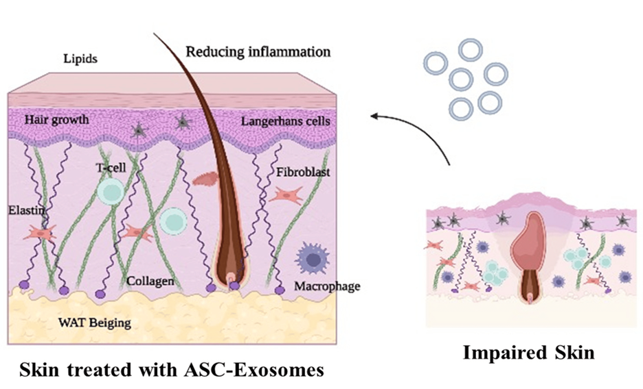
EXOSOMES
BIOLOGICAL FUNCTIONS
Wound healing / Skin repair
DOI: 10.3390/cosmetics10020065

Slide 12
EXOSOMES
HAIR CARE EXOSOMES
SKINCARE EXOSOMES
SUMMARY OF MESOSYSTEM EXOSOMES
TREATMENT PROTOCOL

Slide 13
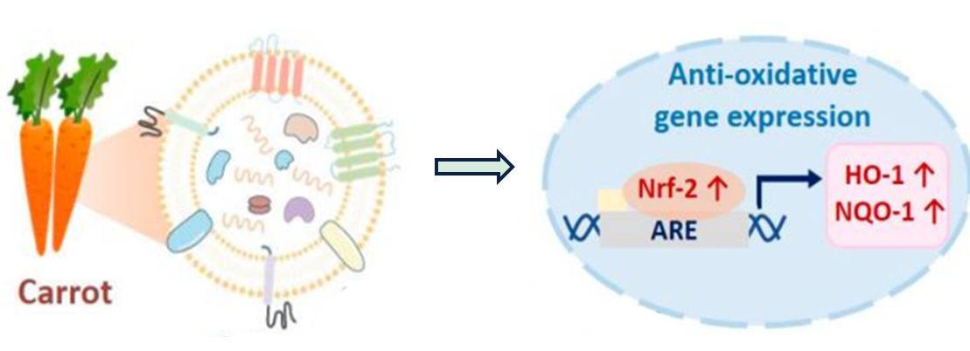
HAIR CARE EXOSOMES
Exosomes in HAIR CARE
Type of Exosomes :
  Carrot exosomes
  MESOSYSTEM Exosomes HAIRCARE:
  Exosomes Hair 5x10ml
  Exosomes Hair 5x1500UI
Source: Plant origin (Daucus carota sativa root extract).
Advantages: Easy extraction, high stability, good tissue penetration, and low immunogenicity.
Derived from carrot root extract.
High antioxidant activity via inhibition of reduction of Nrf-2 (nuclear factor erythroid 2–related factor 2; transcription factor) activation (also antioxidant protein expression increase: HO-1, and NQO-1).
DOI: 10.3390/pharmaceutics13081203
DOI: https://doi.org/10.3390/bioengineering10010104

Slide 14
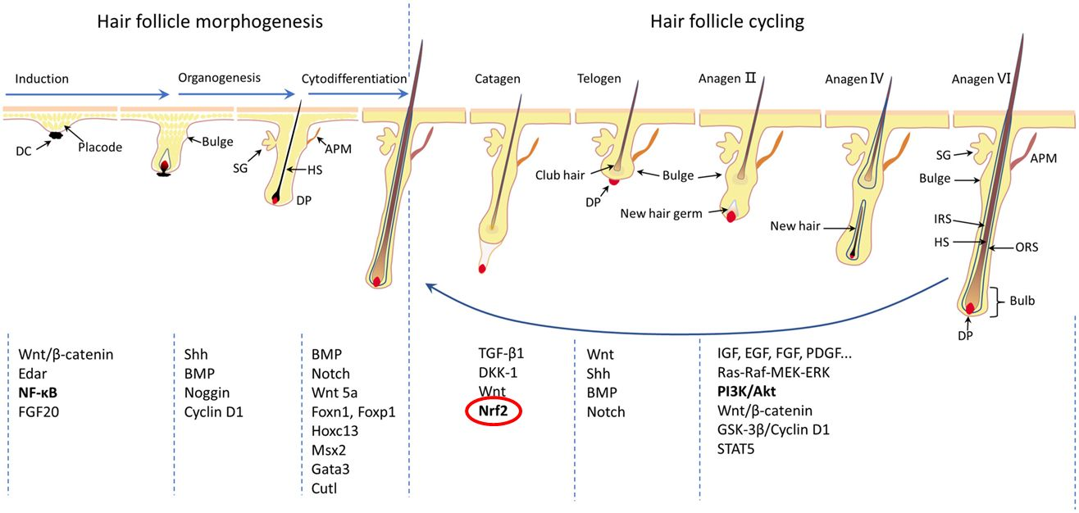
HAIR CARE EXOSOMES
Exosomes in HAIR CARE
HAIR LOSS AND OXIDATIVE STRESS
OXIDATIVE STRESS potential pathogenic mechanism of pathological alopecia.
Oxidative damage in HFs is mainly associated with ROS‐induced DNA damage, lipid peroxide‐induced apoptosis, reduced antioxidant enzyme activity and CHRONIC INFLAMMATION
DOI: 10.1111/jcmm.18486
APM, arrector pili muscle; DC, dermal condensate (black); DP, dermal papilla (red); HS, hair shaft (brown); IRS, inner root sheath
ORS, outer root sheath; SG, sebaceous gland

Slide 15
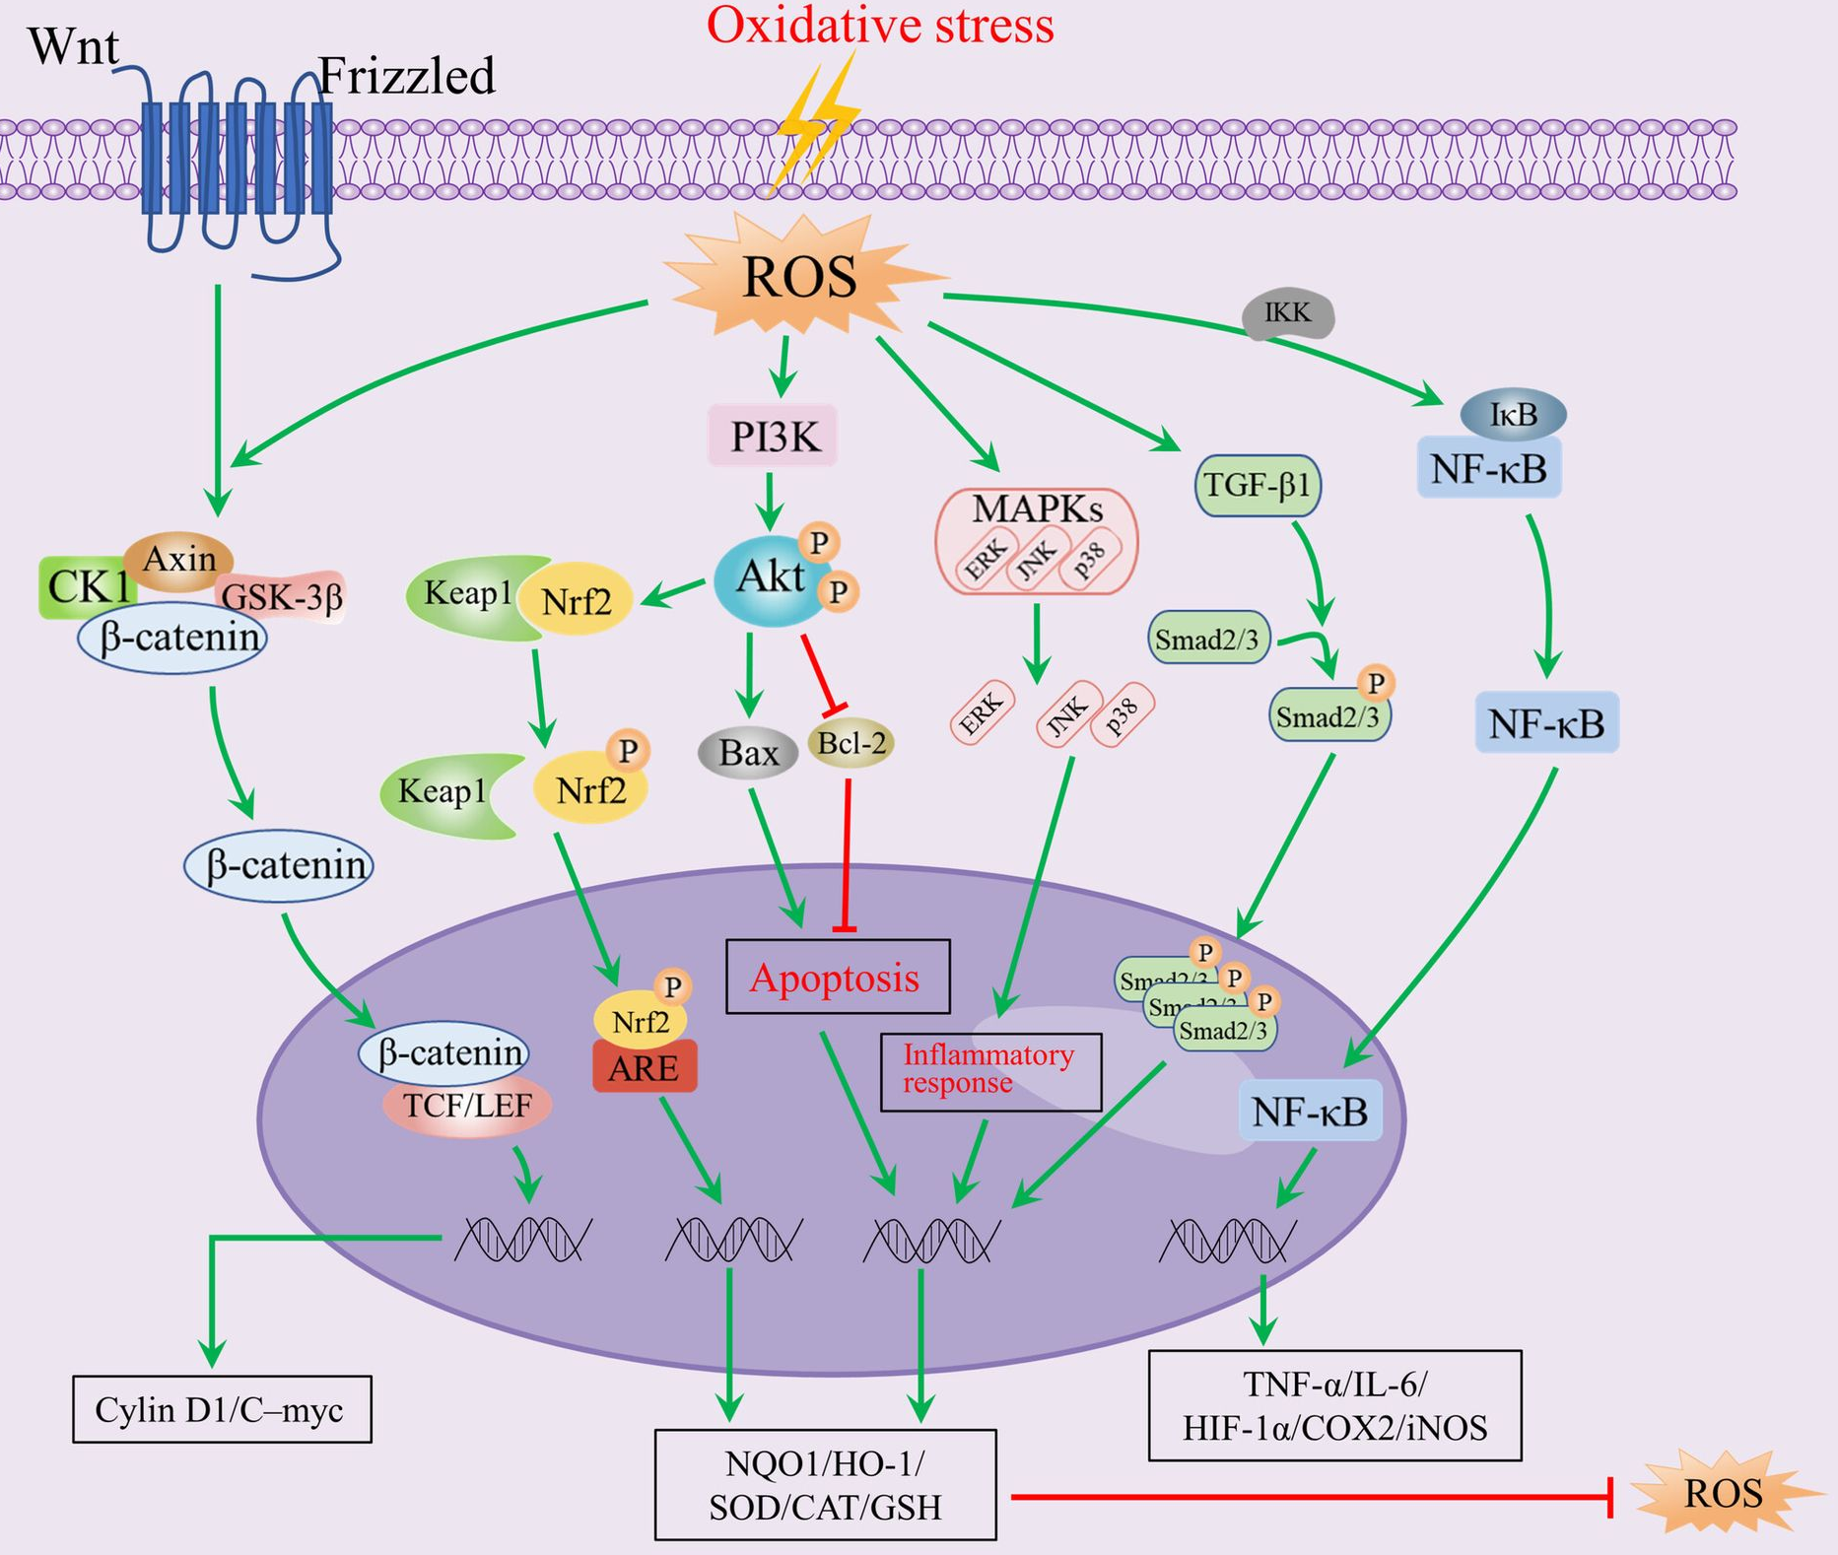

HAIR CARE EXOSOMES
Exosomes in HAIR CARE
HAIR LOSS AND OXIDATIVE STRESS
Nrf2 activation reduced premature catagen and hair growth inhibition induced by oxidative stress
+
Carrot exosomes
REDUCTION
OXIDATIVE STRESS
HAIR FOLLICLE GROWTH
DOI: 10.1111/jcmm.18486
DOI: 10.1016/j.jid.2016.08.035
DOI: 10.1111/jcmm.18486
Nrf2 preactivation reduced premature catagen and hair growth inhibition induced by oxidative stress

Slide 16
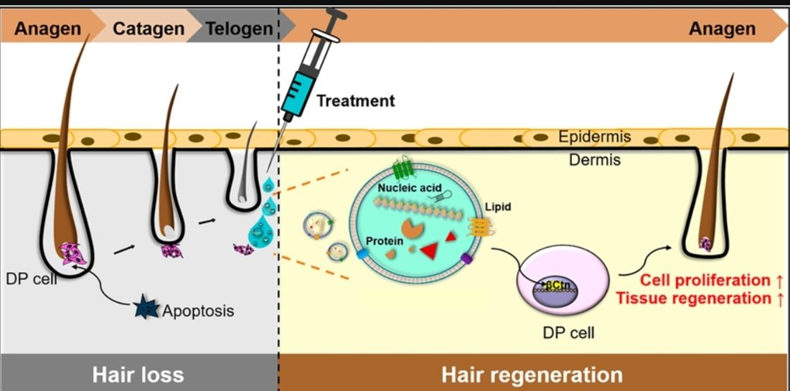
HAIR CARE EXOSOMES
Exosomes in HAIR CARE
TREATMENT
REGENERATION EFFECT OF EXOSOMES THERAPY AFTER APPLICATION -> Proliferation & regeneration
exosomes-mediated phase transition from telogen to anagen for hair regeneration
DOI: 10.3389/fcell.2022.815205

Slide 17
EXOSOMES
HAIR CARE EXOSOMES
SKINCARE EXOSOMES
SUMMARY OF MESOSYSTEM EXOSOMES
TREATMENT PROTOCOL

Slide 18
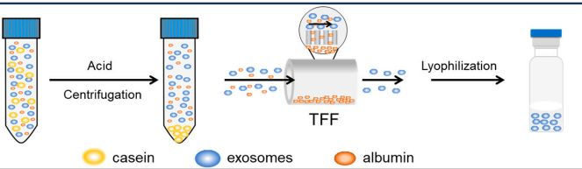
SKIN CARE EXOSOMES
Exosomes in SKIN CARE
Type of Exosomes:
  Milk Exosomes
MESOSYSTEM Exosomes HAIRCARE:
  EXOSOMES PDRN
  EXOSOMES TRANEXAMIC
  EXOSOMES HYALURONIDASE
Source: Pure natural Milk.
From: Separation from casein & albumin proteins and the rest of milk components for purification
DOI: 10.3390/pharmaceutics16070930
DOI: 10.1111/jocd.16112

Slide 19

SKIN CARE EXOSOMES
Exosomes in SKIN CARE
SKIN CARE BIOLOGICAL FACTS
Animals
Skin Allergy
Topical
application
Skin Photo allergy
NO ALLERGIES
In vivo
human
Skin irritation
NO SKIN DAMAGE
EXCELENT SAFETY PROFILE
Skin Sensitization
NO SKIN REACTIONS
31 female
Twice daily (28 days)
Milk Exosomes
Aquaporin 3 (AQP3)
Keratinocytes
filaggrin (FLG)
SKIN MOISTURIZATION
(Epidermis)
CD44 (HA receptor)
In vitro
(cellular
culture)
Gene expression studies
(qPCR & western blotting)
Fibroblast
Hyaluronidase
(HAS2)
SKIN MOISTURIZATION
(Dermis)
SKIN REGENERATION/ANTI-AGING
UV radiation
+
Cell migration
ANTI-WRINKLE EFFECT
+
DOI: 10.1111/jocd.16112
= Upregulation
Collagen (type I & III)

Slide 20
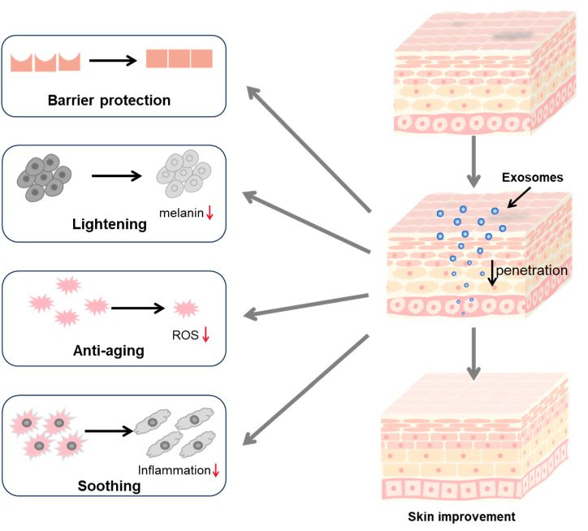
SKIN CARE EXOSOMES
Exosomes in SKIN CARE
SKIN CARE BIOLOGICAL APPLICATIONS
Penetration into the skin layers
High ANTI-AGING CAPACITY
Also possessing HIGH ANTI-OXIDANT capacity.
DOI: 10.3390/pharmaceutics16070930

Slide 21
EXOSOMES
HAIR CARE EXOSOMES
SKINCARE EXOSOMES
SUMMARY OF MESOSYSTEM EXOSOMES
TREATMENT PROTOCOL

Slide 22
SUMMARY OF MESOSYSTEM EXOSOMES
Exosomes HAIR CARE
ANTI-INFLAMMATORY
ANTIOXIDANT
Carrot
Exosomes
HIGHLY SAFE
FOLLICLE GROWTH PROMOTION
DOI: 10.3390/pharmaceutics16070930

Slide 23
SUMMARY OF MESOSYSTEM EXOSOMES
Exosomes SKIN CARE
BRIGHTENING
EFFECT
HIGHLY MOISTURIZING
Milk
Exosomes
HIGHLY SAFETY PROFILE
DERMAL REGENERATION / ANTI-AGING
DOI: 10.3390/pharmaceutics16070930

Slide 24
EXOSOMES
HAIR CARE EXOSOMES
SKINCARE EXOSOMES
SUMMARY OF MESOSYSTEM EXOSOMES
TREATMENT PROTOCOL

Slide 25
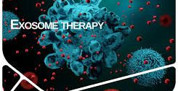
APPLICATION PROTOCOL
APPLICATION PROTOCOL
    USAGE
    2 to 4 sessions recommended, 2 to 3 weeks apart
    Topical use with microneedles
    DOSAGE
    10 mL product per session
    PRECAUTION
    - Not recommended for pregnant & lactating women

Slide 26
ThANK you
I&d MESOSYSTEM

